Slide 1

Predictive Modeling for TAVR Surgery Adverse Events
Harriet Smith, Abdulmalik Ajisegiri, Benjamin Thomas

Slide 2
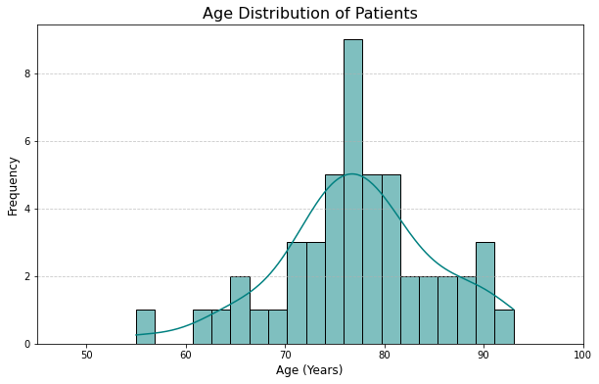
The desired outcome is a model that predicts the Operative Mortality of a TAVR surgery given several variables. This project will discuss an approach to reach Operative Mortality modeling with an r-squared of 0.81, and MSE of 0.12
Desired Outcome

Slide 3

Data Preprocessing & Variable Assignments
Blank (NaN) datapoints in the Complications variable were filled with "No Complication"
Operative Mortality set as the Target
Morbidity & Mortality, Stroke, Renal Failure, Reoperation, Prolonged Ventilation, Long Hospital Stay, Short Hospital Stay, Age, BMI, Complication, Sex, and Insurer initially set as the Features
Blank feature values were dropped
Sex, Complication, and Insurer were made categorical

Slide 4
Modeling techniques chosen for their ability to handle non-linear, non-normal data with limited sample size and uneven class distribution
Data Preprocessing & Variable Assignments
Random Forest Regression: Handles non-linear relationships and is robust against outliers.
Gradient Boosting: Optimizes prediction accuracy by reducing error iteratively.
**Removal of outliers only marginally increased model performance and required removal of Complication classes due to class size. Outliers were thus left in the dataset due to the models' inherent ability to accept outliers.

Slide 5
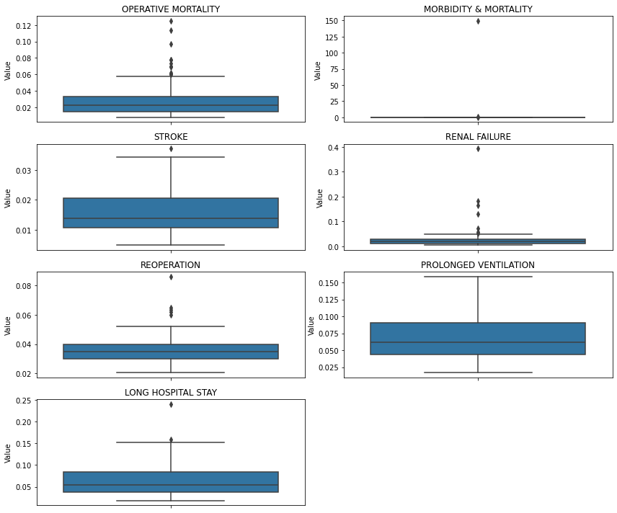
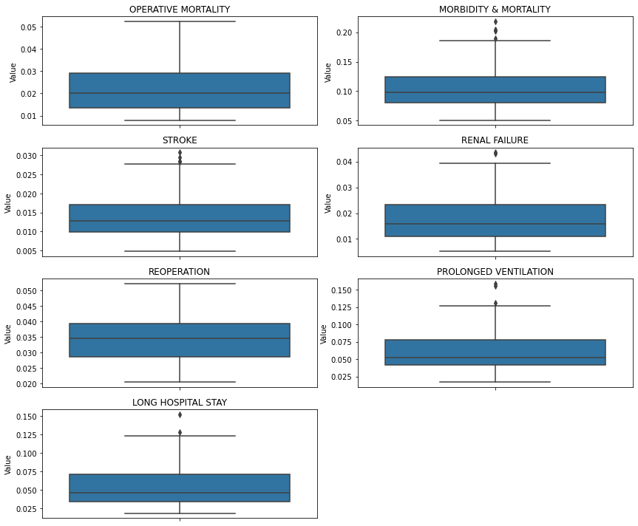
Before Outlier Removal
After Outlier Removal

Slide 6
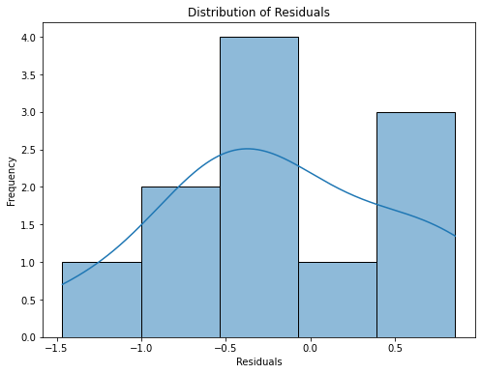
Random Forest Regression and Gradient Boosting were stacked to increase robustness, reduce error, and avoid overfitting
Stacking of the models greatly improved the r-squared value to 0.80 and reduced the MSE to 0.49
High MSE might be explained through undesirable residual distributions, shown at right

Slide 7
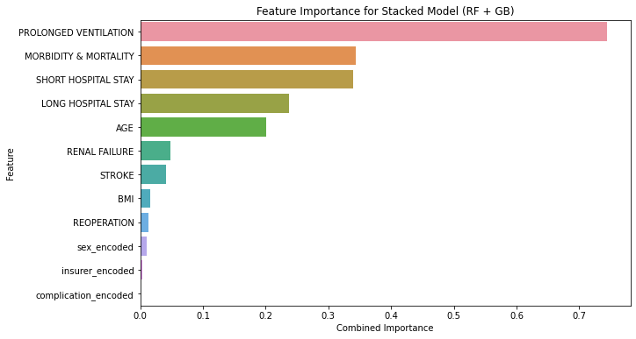
Incorporating a Yeo-Johnson Transformation greatly reduced MSE and preserved r-squared
With Yeo-Johnson Transformation, the r-squared value was 0.79, and the MSE was 0.13.
Shown at right, there were similar importance rankings for specified features, suggesting the need for Variance Inflation Factor (VIF) analysis.
VIF assesses the degree to which the correlation between feature variables impacts the final regression outcome

Slide 8
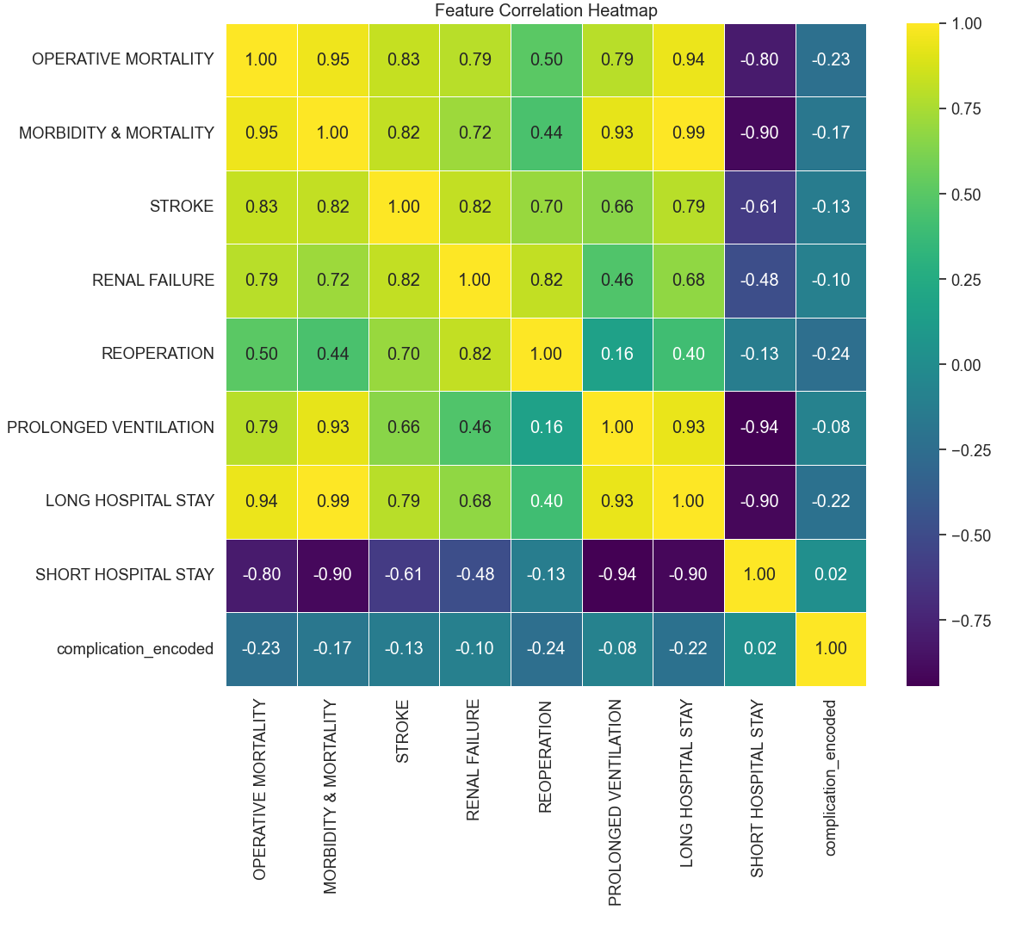
Impact of Feature Correlation on Regression

Slide 9
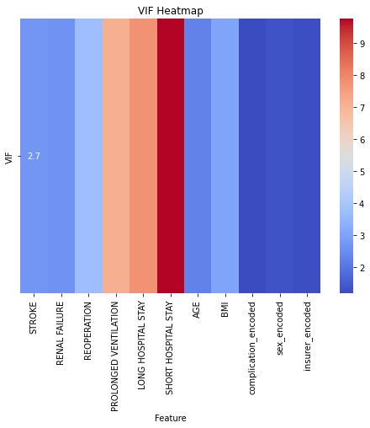
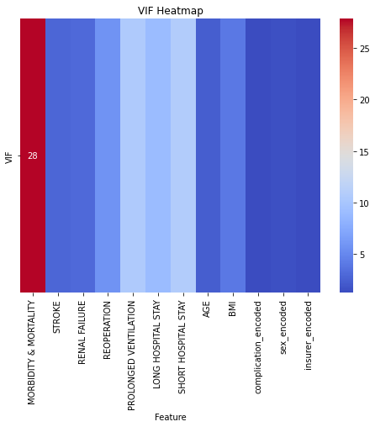
Based on a VIF threshold of 10, Morbidity & Mortality was removed. This yielded an MSE decrease and r-squared increase.

Slide 10
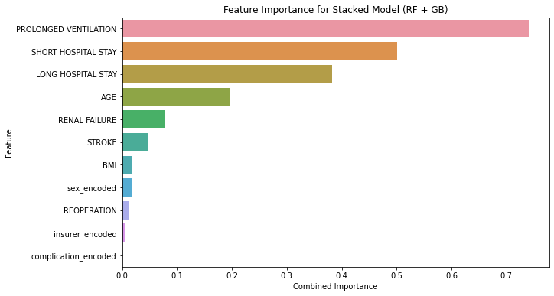
Combined Random Forest Regression and Gradient Boosting with Yeo-Johnson Transformation yielded a final r-squared of 0.81, and MSE of 0.12

Slide 11
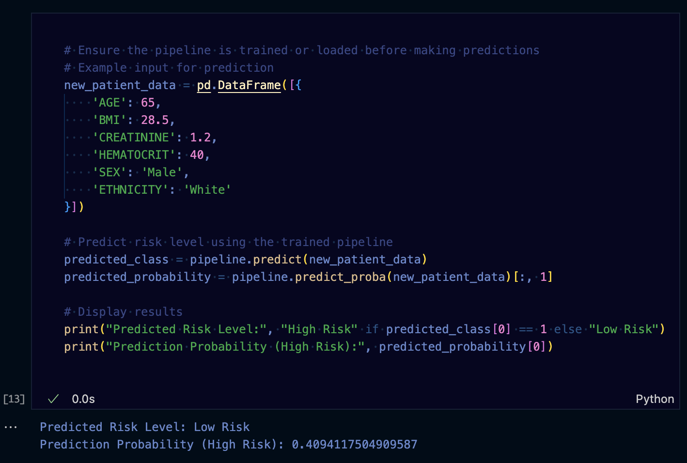
How the Model Becomes Predictive
Input Patient Data:
- Clinicians input key features to the model via an interface or API:
- Age, BMI, Creatinine, Hematocrit, Sex, and Ethnicity.
Prediction Workflow:
Pipeline Execution:
- Ensure the predictive pipeline is trained or loaded before use.
Outputs:
- Predicted Risk Level (e.g., High/Low Risk)
- Prediction Probability for risk level.

Slide 12
Practical Considerations Based on Findings
1. Model Effectiveness:
Predicts operative risks reliably, demonstrated by a Low Risk prediction and a 40.9% High Risk probability for example patient data.
2. Demographic Validation:
Works well for older patients (peak age ~80), but accuracy for younger demographics may be limited due to data bias.
3. Actionable Insights:
Prioritize high-risk patients for pre-operative care.
Integrate into decision-making tools for better clinical workflows.

Slide 13
Next Steps
Training the model on a larger dataset & achieve higher R scores
Changing Complication classifications to become more balanced
Leverage regressions to fill the data gaps, without additional raw data
Layer the models to first correctly predict the presence of a Complication, then assess likelihood of specific Complications
Explore addition of various lifestyle factor variables to the dataset, i.e., diet, living condition, level of education, etc.
Modify the existing approach to allow for "true modeling" - novel inputs and outputs

Slide 14

Outcomes & Challenges
Random Forest Regression and Gradient Boosting models might benefit from additional tuning
Imbalance of data and limited class availability might have contributed to poor residuals
Utilization of additional variables not included in the dataset, or better utilization of the Complication information may yield improved results
Overall, an r-squared of 0.81 and MSE of 0.12 indicate a relatively strong model with decent goodness of fit to the data.

Slide 15
Sources
Chen, Lingxiao. “Overview of Clinical Prediction Models.” Annals of Translational Medicine, U.S. National Library of Medicine, Feb. 2020, pmc.ncbi.nlm.nih.gov/articles/PMC7049012/.
Kuhn, Max, and Kjell Johnson. Applied Predictive Modeling. Springer New York, 2016.

